Slide 1


Progress report presentation as part of master study and research on going at Uganda Martyrs University
By Sènami Irène Bossavi
2024-M152-24867

Slide 2
Succesfully completed courseworks
Systems and agroecologies
Agrometrology and ecosystem modeling
Fundamentals of biotechnology
Agro biodiversity and ecosystem conservation
Research and statistical methods
Ecological resource economics and entrepreneurship
Livestock management
Integrated pest Management
✅Supervisor assigned: Dr John Byalebeka
✅Full proposal writen
✅Successful proposal defense on May 14th

Slide 3
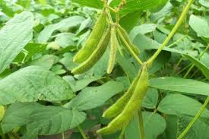
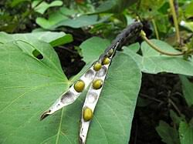
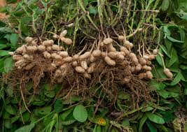
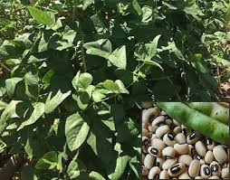
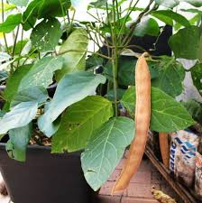
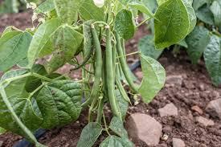
TOPIC ASSESSMENT OF Nitrogen ContributionS Of Different LegumeS Grown on Ferralitic Soil IN CENTRAL UGANDA

Slide 4
Background
Agriculture remains the economic sector most sensitive to the negative effects of climate change because the high temperatures brought by that change reduce the yields of useful crops (Bakhtache and Hadjene, 2023).
The quest to improve yields has led the global food system to an addiction to chemical fertilizers (Grain, 2022).
Chemical
Fertilizers
Yield
GHG Emission

Slide 5
Background cont’d: Fertilizers, source of anthropogenic Greenhouse gases
Some stats
Agricultural sector is responsible for approximately 100 billions tons of CO2 and nearly half of these emissions is attributed to the production and use of N fertilizers. In 2020, 85 million tons of nitrogen (N) were applied to agricultural land (Minyasan 2022).
An increasing of more than 50% is expected by 2050, according to the FAO (IATP, Greenpeace International et GRAIN 2021)
Alternative??: Legumes can help reduce the use of chemical fertilizers (important factors of climate change) and decrease greenhouse gas emissions(FAO 2024).

Slide 6

Problem statement
Legumes are assumed to improve soil fertility through the nitrogen fixation process.
Consequently, farmers are always advised to have legumes in their crop rotation schedules with the hope that the legume will add nitrogen to the soil
The amount of nitrogen fixed and added to the soil by a particular legume is heavily influenced by many abiotic and biotic factors such as: legume species, presence of the required rhizobia in the soil, soil temperature, soil pH, prevailing soil fertility status, etc.

Slide 7
Problem statement cont’d
The different amounts of nitrogen added to soil by different legumes growing on same soils and under the same environmental conditions have not been well established.
Therefore, the purpose of this study is to investigate the amounts of nitrogen added to the soil by different legumes and how those amounts of nitrogen affect the growth and yield of a cereal crop (maize) planted on the same soil after the legumes have been harvested.

Slide 8

General objective
To evaluate the nitrogen contribution of different legume species to a ferralitic soil and subsequent maize crop
(i) To investigate the nodulation capacity of the different legumes (Canavalia ensiformis, Vigna radiata, Glycine max, Vigna unguiculata, Arachis hypogea and Phaseolus vulgaris) growing on a ferralitic soil.
(ii) To quantify the amounts of nitrogen added to the soil by the different legume species growing on a ferralitic soil.
(iii) To investigate the contribution of the different legume species to the growth and yield of maize grown in rotation with the legumes.
(iv) To compare the potential of Canavalia ensiformis, Vigna radiata, Glycine max, Vigna unguiculata, Arachis hypogea and Phaseolus vulgaris as resources for nitrogen fixation and soil N buildup.

Slide 9
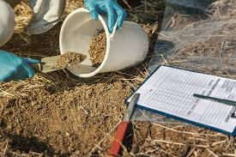
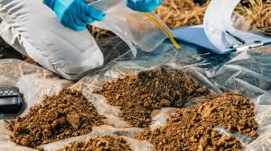
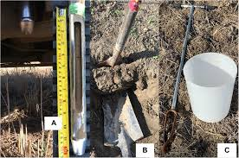
Data collection and Analysis
 | Data to be collected | Output
 | Basic data: Germination percentage at 14 DAP
SO1 | Number of nodules and rate of active nodules at 50% of plants flowering stage | The nodulation capacity of each legume species
SO2 | Before planting of legumes : Soil sampling and laboratory analyses to determine total soil N After legumes harvesting: soil sampling per legume specie and laboratory analyses to determine nitrogen in the soil . | Quantity of total soil N before and after the legumes
SO3 | Plant biomass at tassling stage : Weight of plants Weight of cobs per plot Grain yield | Assess maize performance in rotation with each of the legumes
SO4 | Results obtained in SO1, SO2 and SO3 will be compared for ranking the different species of legumes in terms of their contribution in N buildup | Rank of legumes according to their nitrogen fixation and soil N buildup capacity and recommendation (compost/rotation)

Slide 10
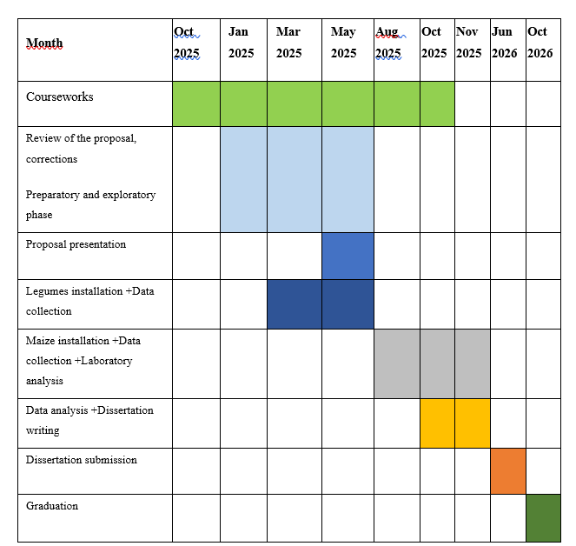
Timeline

Slide 11
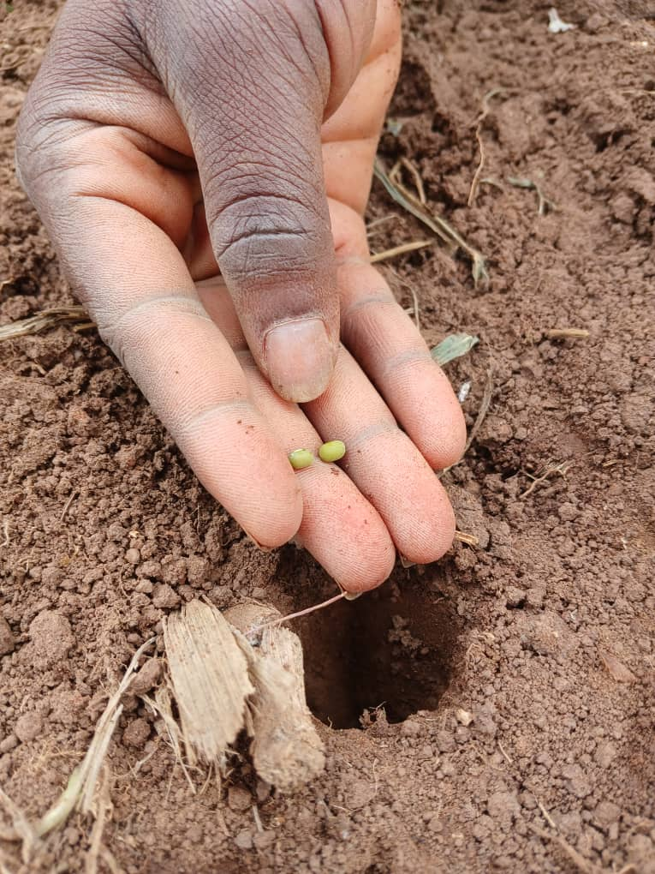
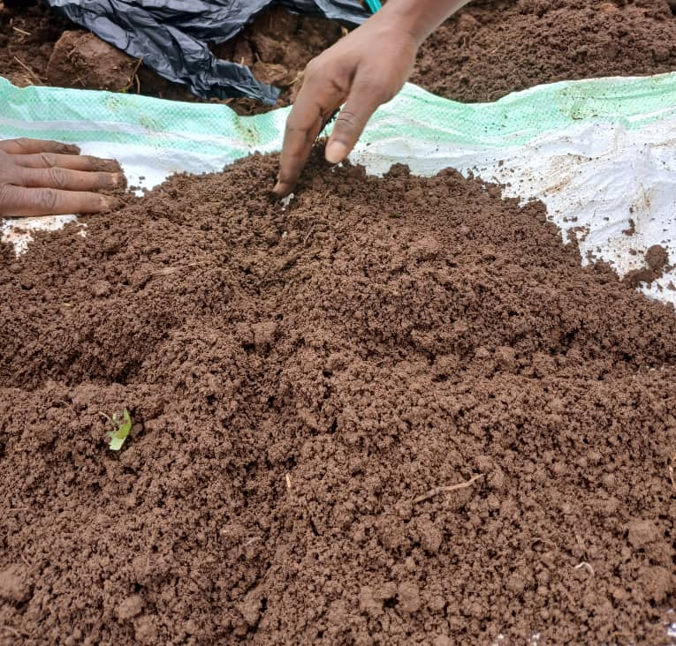
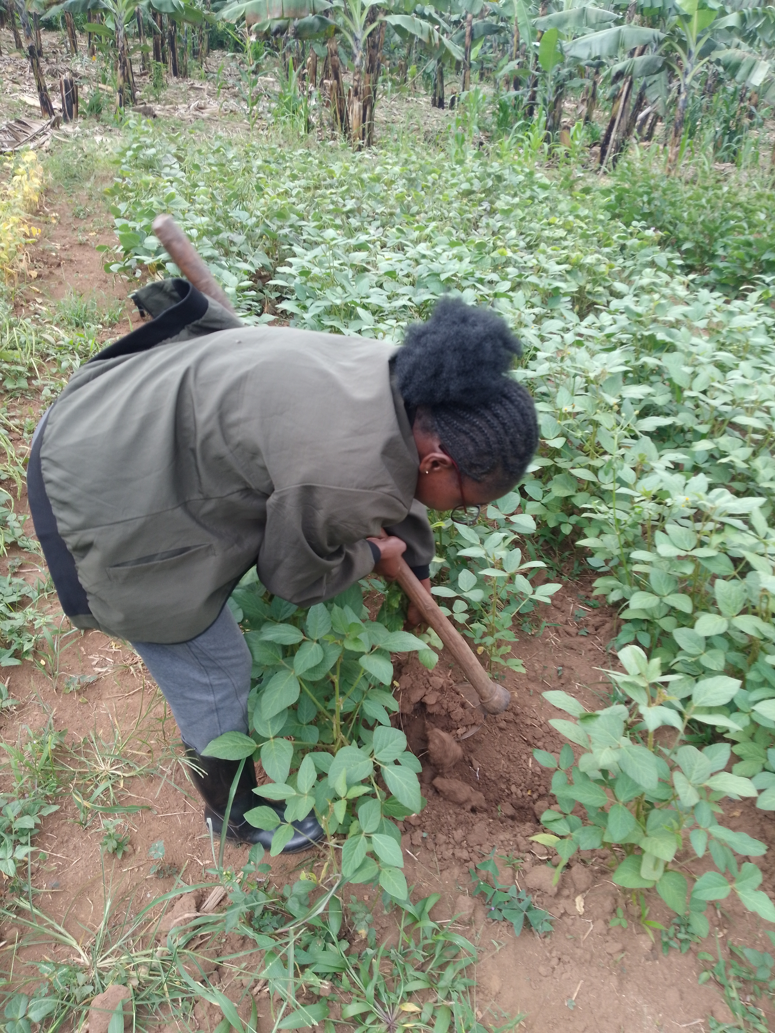
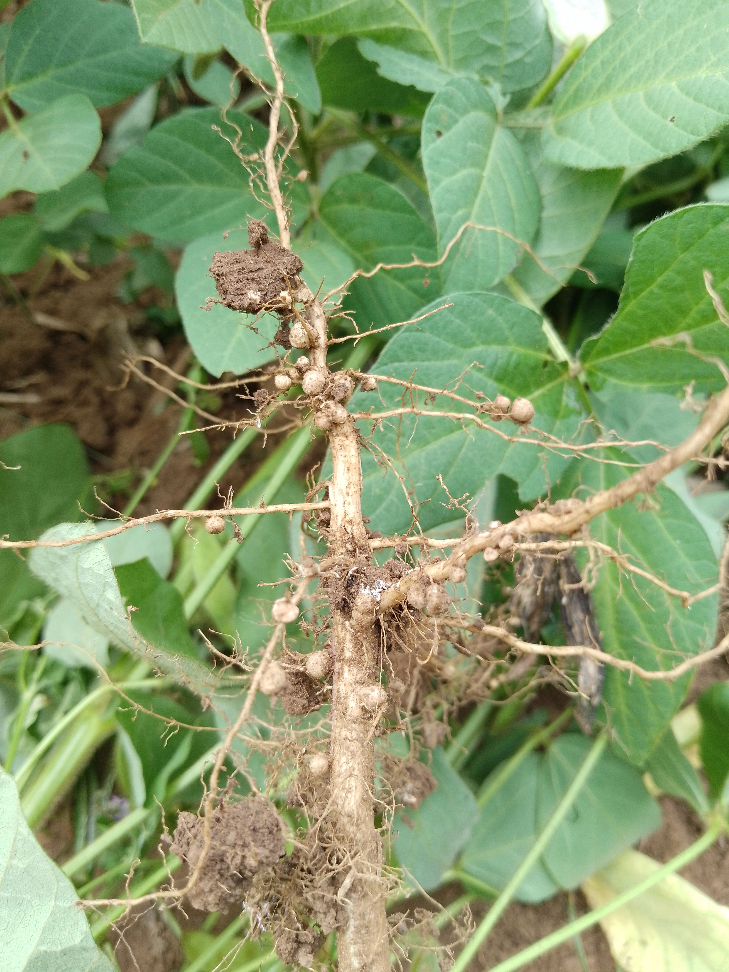

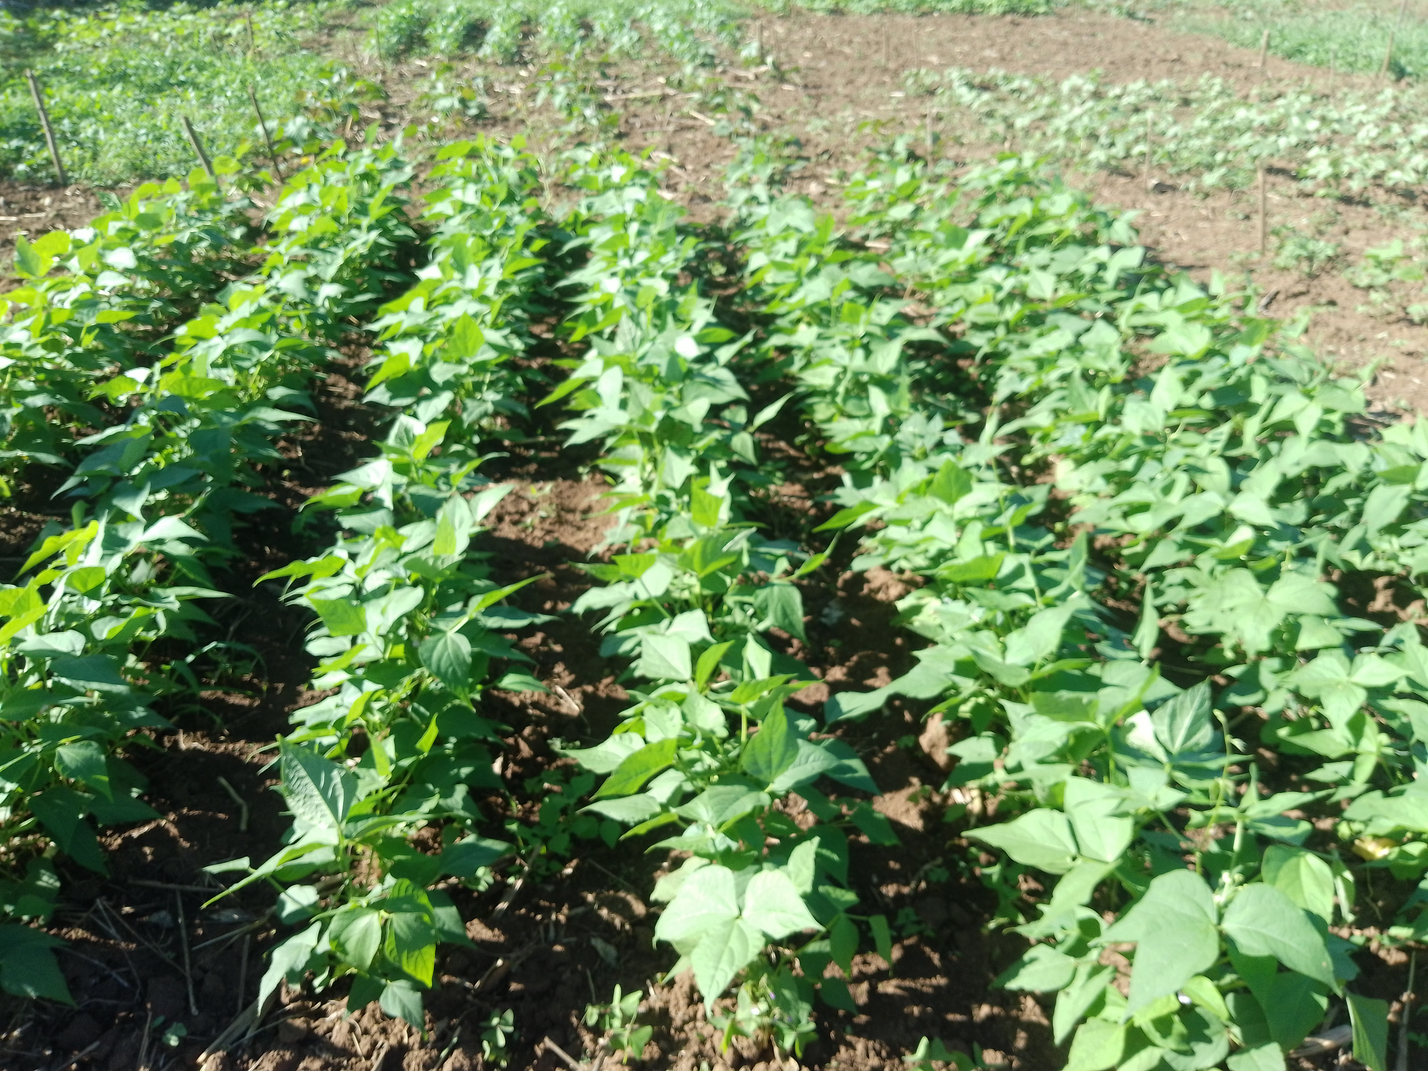
On going research & Other activities(Conferences attendance)

Slide 12
Reference
Agronomie, Ecologie et Innovation. (2019). Fertilité en grande culture bio. 5(104).
Bakhtache, R., & Hadjene, O. (2023). The repercussions of climate change on the agricultural and hydraulic sectors in Algeria (2010/2022). 14(01), 80–95.
FAO. (2024). Les légumineuses et les sols: Un duo dynamique.
IATP, Greenpeace International et GRAIN. (2021). New study shows that to address the climate crisis, we must end 50 years of overconsumption of chemical fertilizers.
Guinet, M., Nicolardot, B., Durey, V., Revellin, C., Lombard, F., Pinet, E., Bizouard, F., & Voisin, A.-S. (2019). Fixation symbiotique de l’azote et effet précédent : Toutes les légumineuses à graines se valent-elles ? Innovations Agronomiques, 74, 55–68.

Slide 13

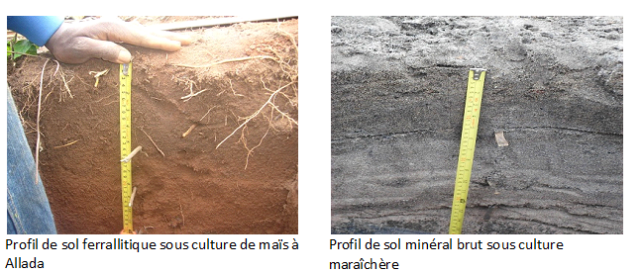
Thanks for your KIND attention

